Slide 1

Network Port Scanner GUI
Student Name : Srinivas
AICTE ID: STU68ea313b6381c1760178491
College Name : Government Engineering College -Raichur, Karnataka

Slide 2

PROBLEM STATEMENT
Network professionals and students frequently need to discover which TCP ports are open on a target machine. Existing tools like nmap require command-line knowledge, separate installation, and are not beginner-friendly. There is a need for a simple, cross-platform graphical tool that anyone can use without prior networking expertise.

Slide 3
Project Description A lightweight and user-friendly TCP port scanning application developed using Python and Tkinter. This tool allows users to enter a target IP address or hostname along with a port range, and efficiently scans for open ports using multi-threading. The application displays results in real-time, including commonly known services (like HTTP, SSH, etc.), making it useful for students, network administrators, and cybersecurity beginners. It requires no external libraries and works across multiple platforms. Key Features: Simple GUI (Target, Start Port, End Port) Fast multi-threaded scanning Real-time results display Cross-platform (Windows, Linux, macOS) No external dependencies

Slide 4

WHO ARE THE END USERS?
Who uses this application:
👨‍🎓 Students & Learners To understand networking concepts and port scanning basics
🧑‍💻 Network Administrators To check open ports and monitor network security
🔐 Cybersecurity Beginners To practice vulnerability analysis and ethical hacking basics
🏢 IT Professionals To troubleshoot services and identify running applications on systems
🧪 Developers & Testers To verify if specific ports/services are active during development

Slide 5

Technology Used
🐍 Python (3.7+) Core programming language used to build the application
🖼️ Tkinter (GUI Framework) Used to design the graphical user interface (no external libraries needed)
🌐 Socket Programming Used to establish TCP connections and scan ports
⚙️ Multithreading (threading module) Enables fast and efficient scanning of multiple ports simultaneously
📊 Queue Module Handles communication between threads and GUI safely
⏱️ Time Module Used for tracking scan duration and performance

Slide 6
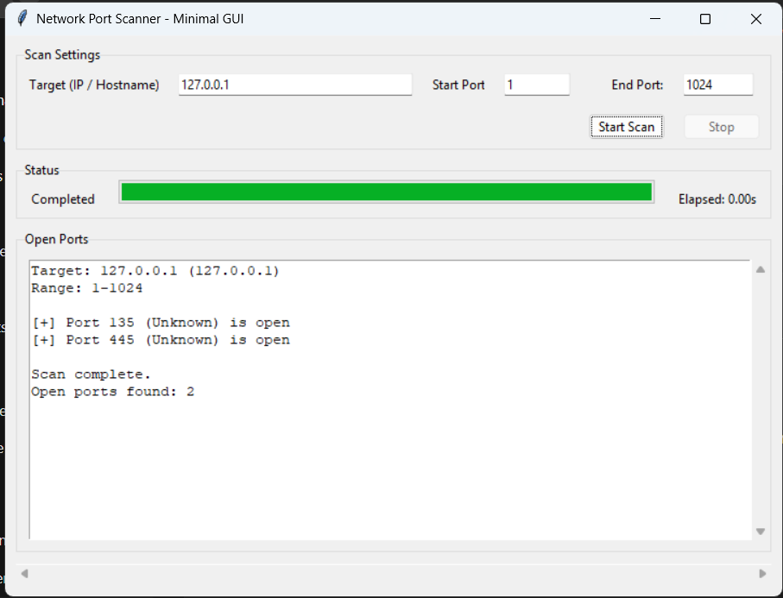
RESULTS
Demo Link

Slide 7
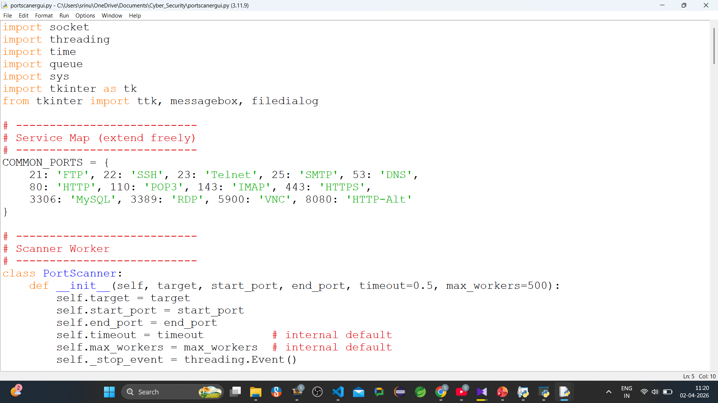
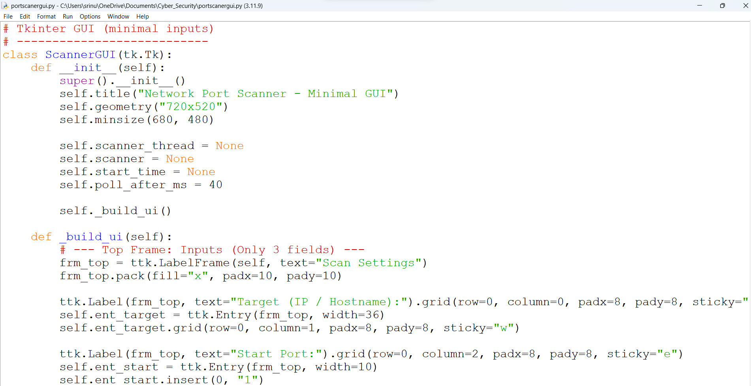
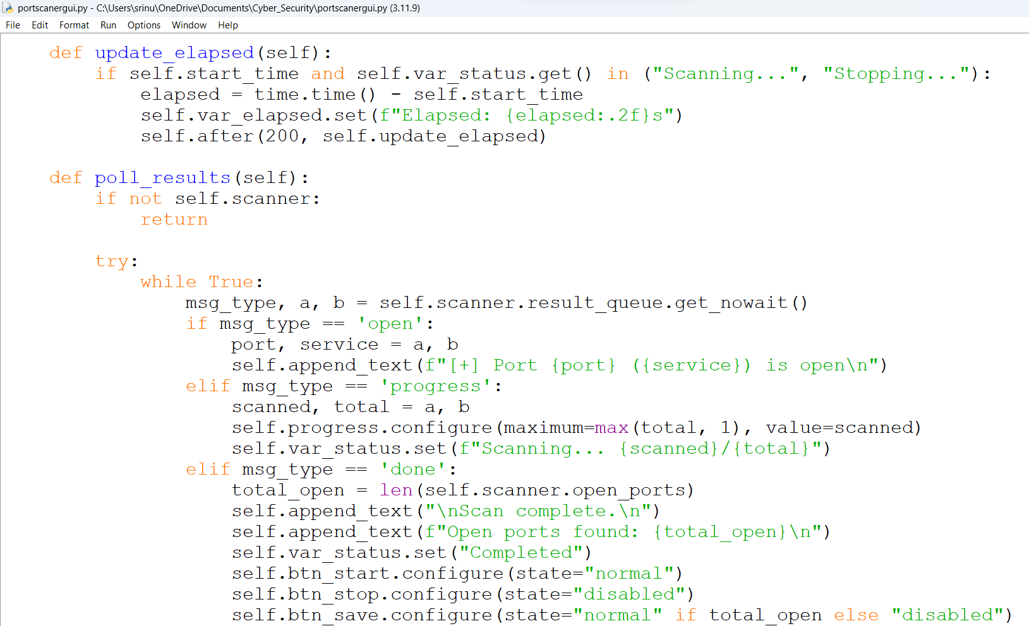
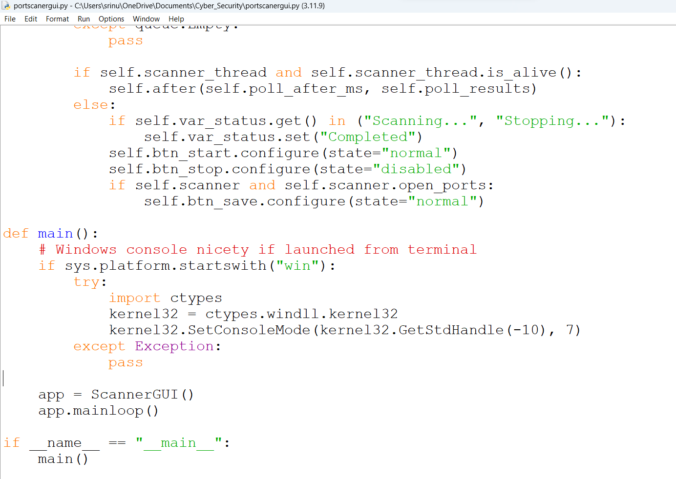
RESULTS
[Add screen shots of your code ]
Demo Link

Slide 8
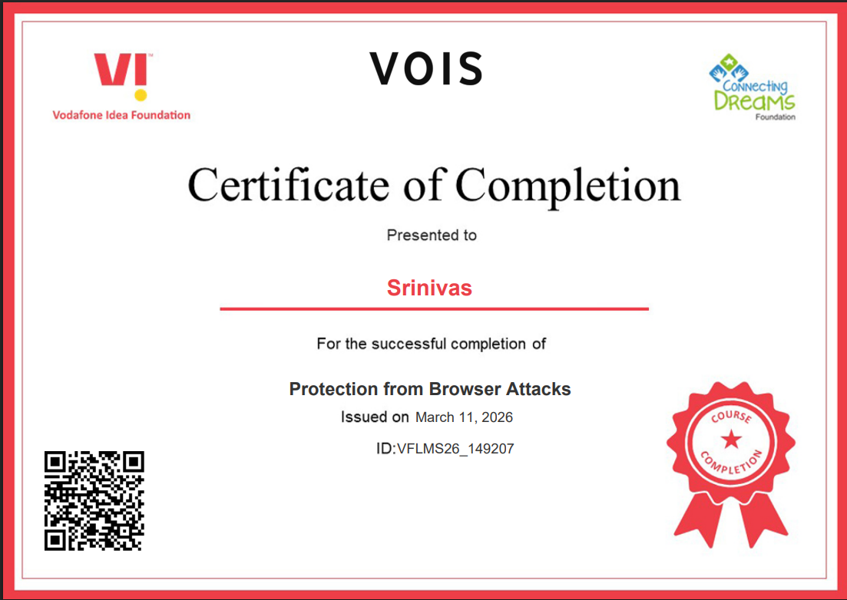
Certificate - Protection from browser attacks

Slide 9
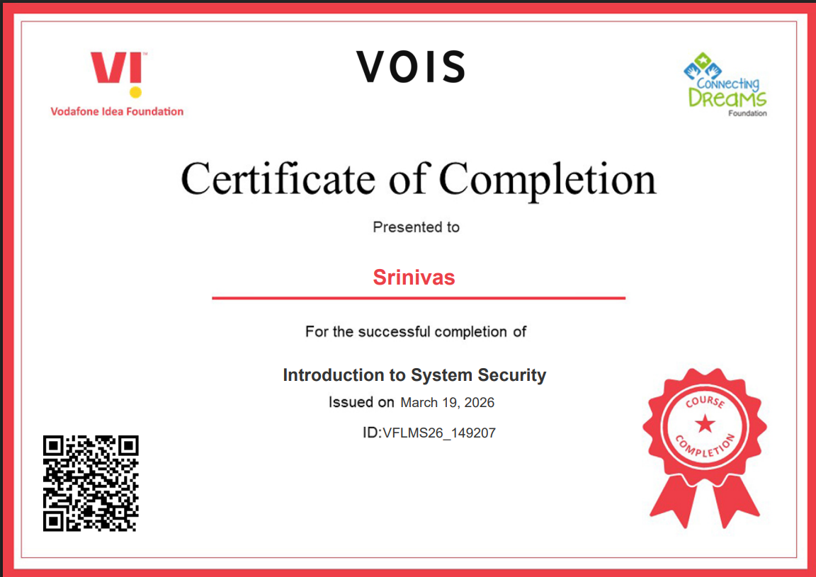
Certificate - Introduction to System Security

Slide 10
GitHub link
https://github.com/srinivas-pullela/Network-Port-Scanner-GUI

Slide 11
Thank you for your time and attention
🙏 Thank You
.
.

